Slide 1

CI PIPELINE PROJECT
USING JENKINS AND GITHUB
BY:- JATIN SHARMA
TO:-MR. ASHISH MITTAL

Slide 2

LEARN AND BUILD(PROJECT)
“FINAL PROJECT”

Slide 3

JENKINS:-
Jenkins is an open-source automation server widely used for building, deploying, and automating projects, especially in the field of software development.
Pipeline Automation: Jenkins allows you to define your build and deployment processes as code using a domain-specific language called "Pipeline DSL."
Distributed Builds: Jenkins can distribute the build and test workload across multiple nodes, speeding up the process and efficiently utilizing available resources.
Security: Jenkins provides security features to control access to its web interface and restrict who can execute or configure jobs.
Extensibility: If Jenkins doesn't have a feature you need out of the box, you can extend its functionality by writing custom plugins or using existing ones from the Jenkins Plugin Index.

Slide 4

GIT-HUB:-
GitHub is a web-based platform and service that provides tools for version control and collaborative software development.
It is widely used by developers and teams to host, manage, and collaborate on code repositories.
GitHub Pages: GitHub Pages is a feature that allows you to host static websites directly from your GitHub repository. It's commonly used for documentation or project websites.
GitHub Actions: GitHub Actions is an integrated continuous integration and continuous deployment (CI/CD) platform. It allows developers to automate workflows, run tests, build and deploy code directly from GitHub repositories.

Slide 5
COMPARISON
JENKINS AND GIT-HUB
JENKINS:-
GITHUB:-
Purpose:
Jenkins is primarily an automation server used for Continuous Integration (CI) and Continuous Delivery (CD) processes. It automates tasks such as building, testing, and deploying code.
Key Features:
Automation of CI/CD pipelines.
Integration with various build tools, source code repositories, and deployment platforms.
. Use Cases:
Building, testing, and deploying code.
Running automated tests and checks.
Purpose:
GitHub is primarily a web-based platform for version control, code collaboration, and project management.
Key Features:
Git-based version control system.
Code hosting and collaboration features, including pull requests, issues, and code reviews.
Use Cases:
Hosting and managing code repositories.
Collaborative development and code review.

Slide 6

BIG IMAGE
MAIN COMPONENT (LINUX)

Slide 7
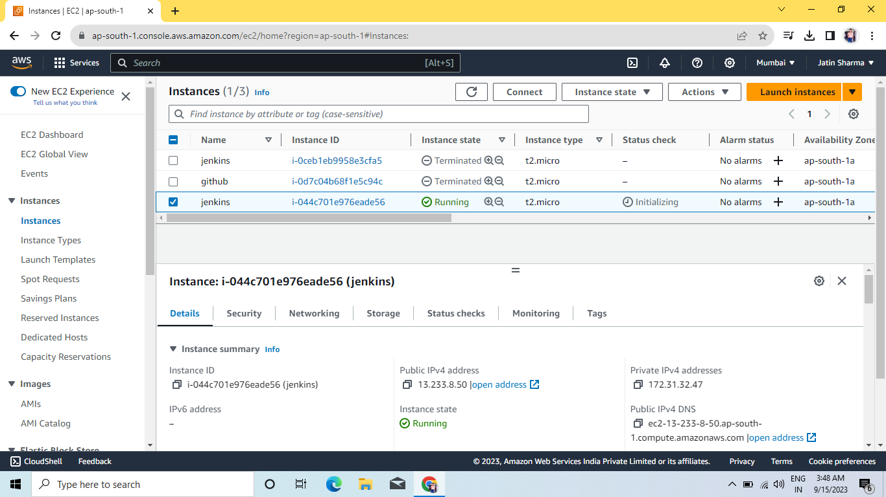
LAUNCH AN INSTANCE OF JENKINS:-

Slide 8
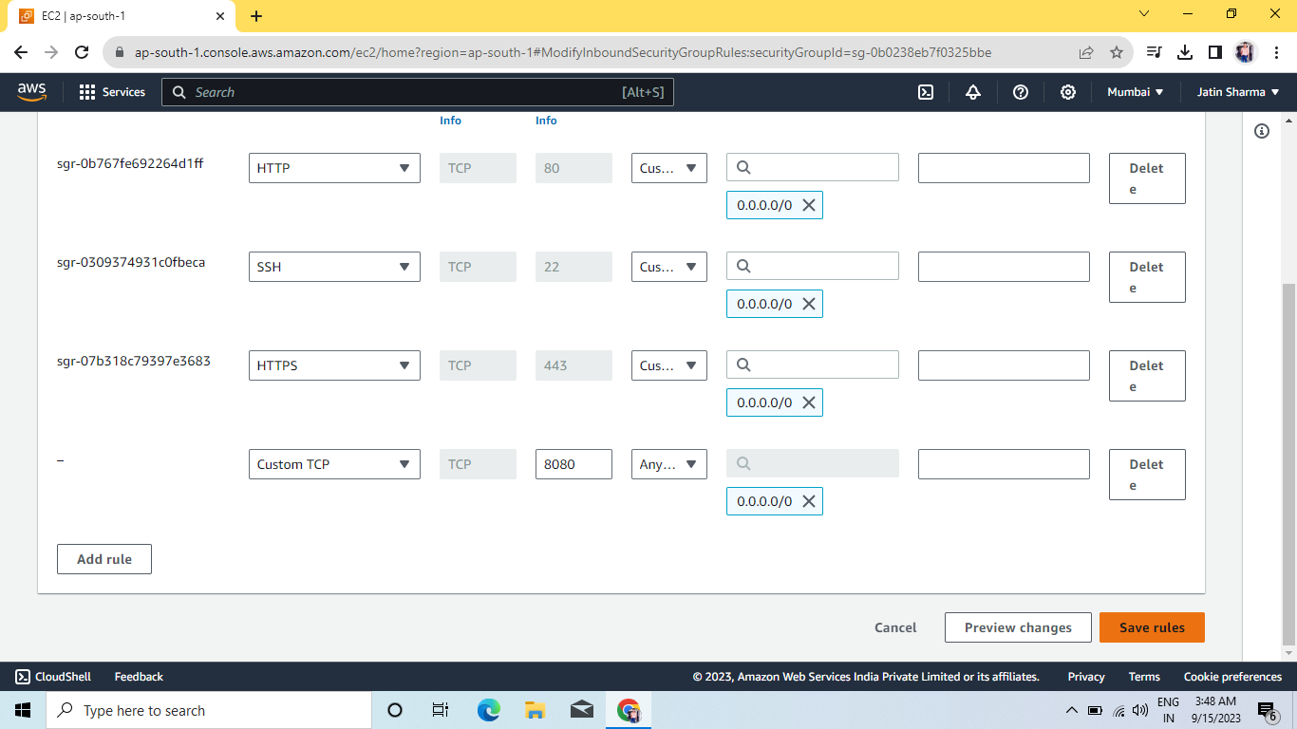
ALLOW PORT:-8080 FOR JENKINS:-

Slide 9
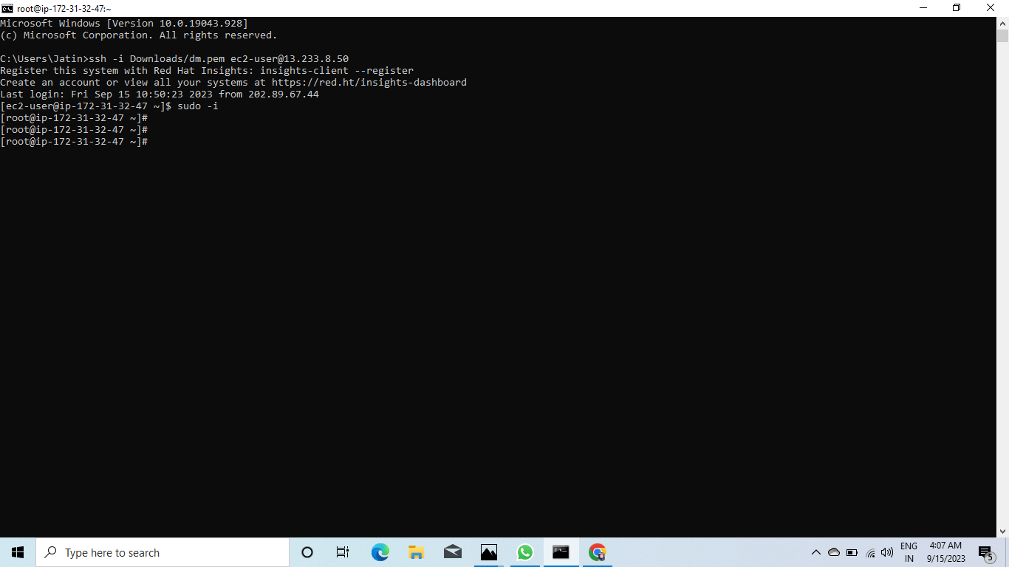
COME TO ROOT USER AT CMD:-

Slide 10
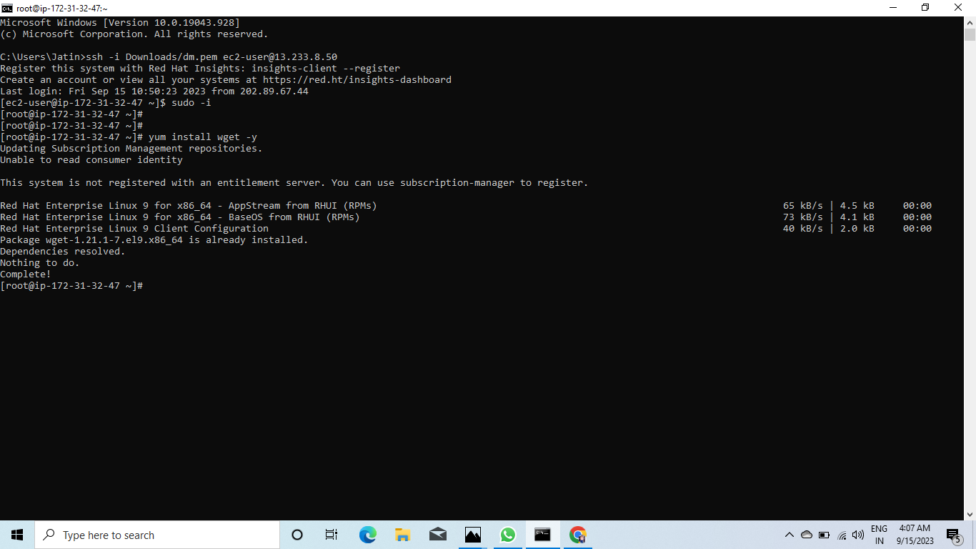
YUM INSTALL WGET:-

Slide 11
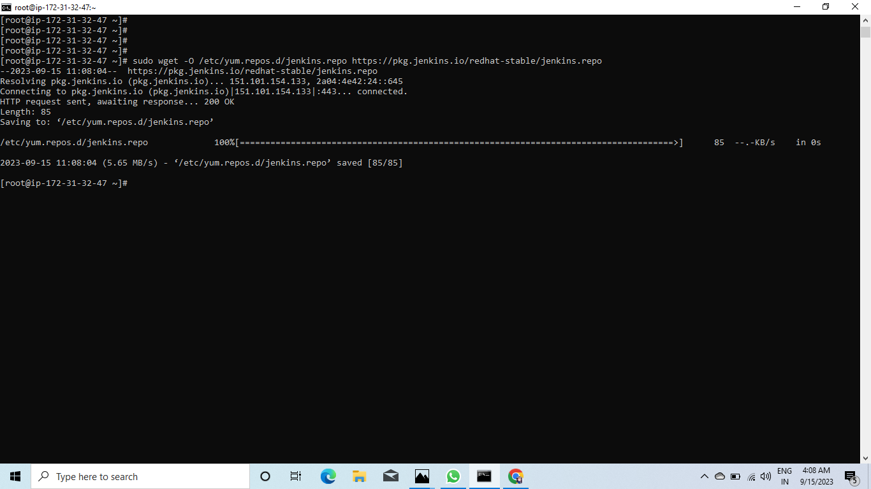
RUN A COMMAND WHICH IS NECESSARY FOR INSTALLATION:-

Slide 12
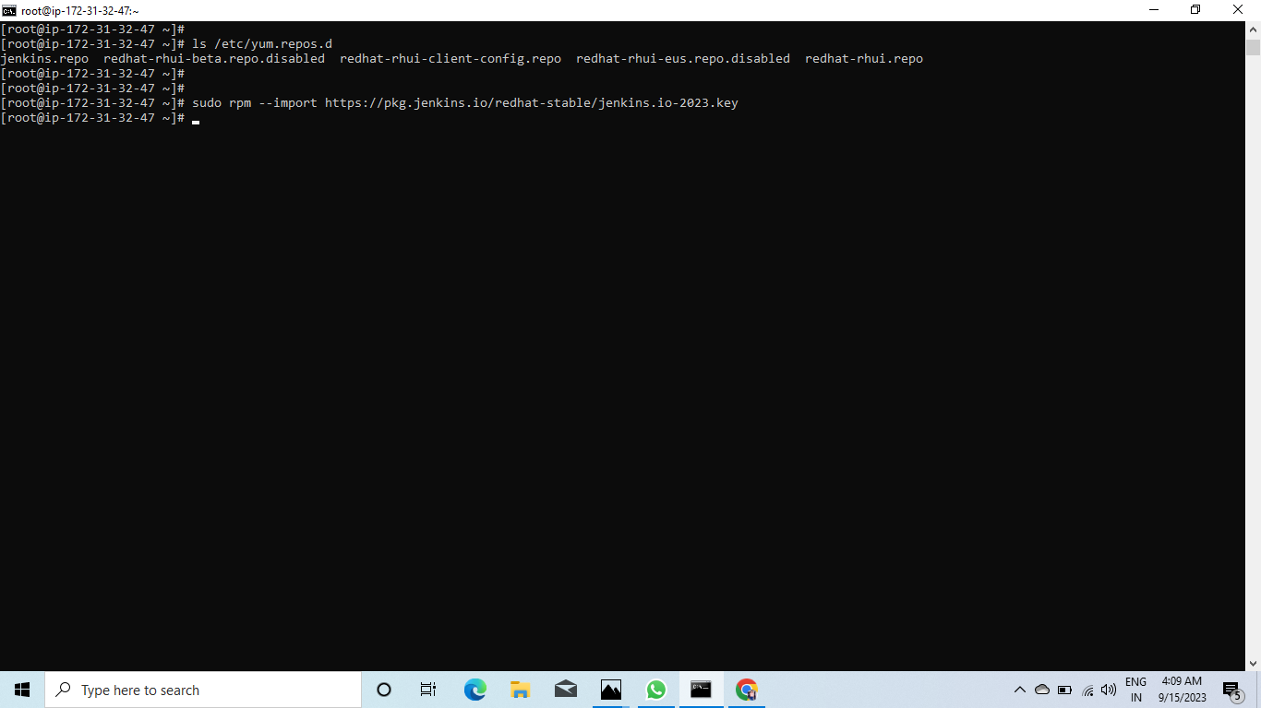

Slide 13
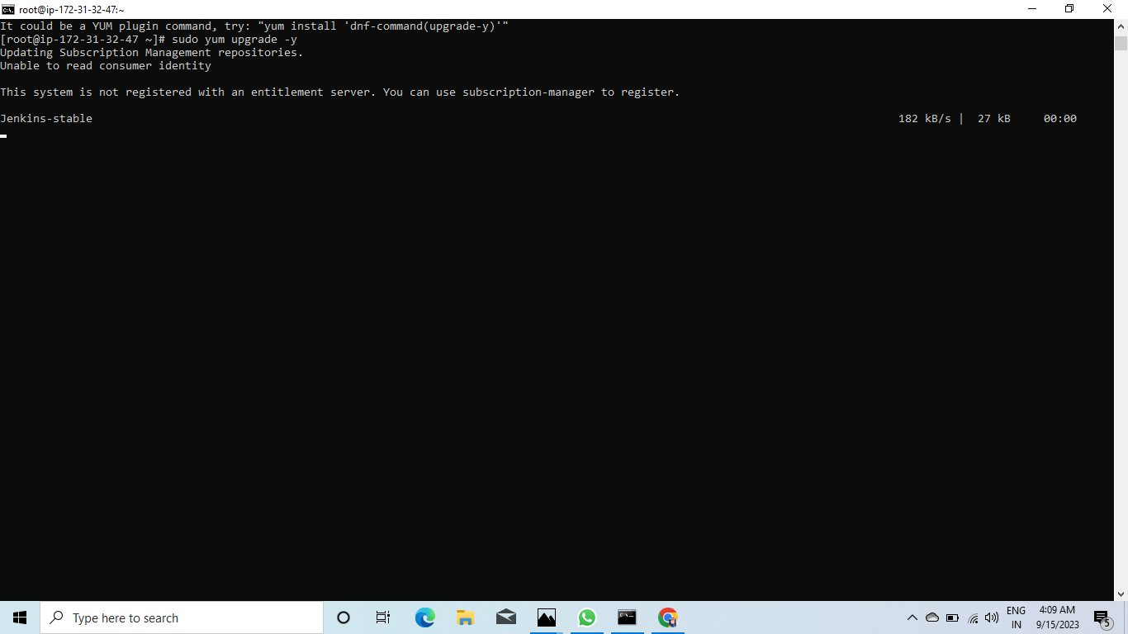

Slide 14
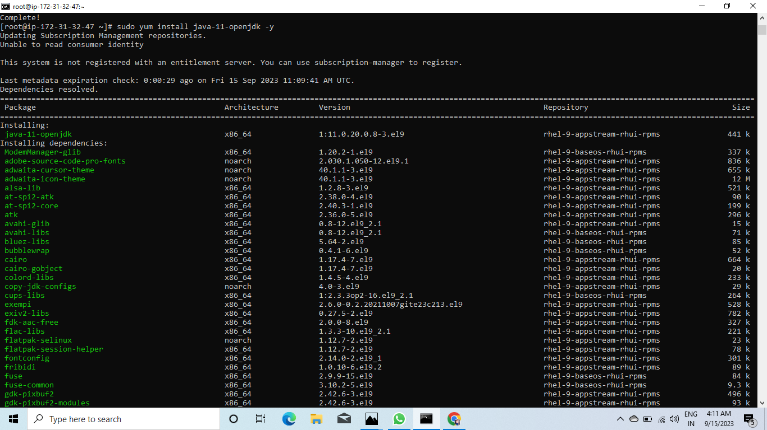

Slide 15
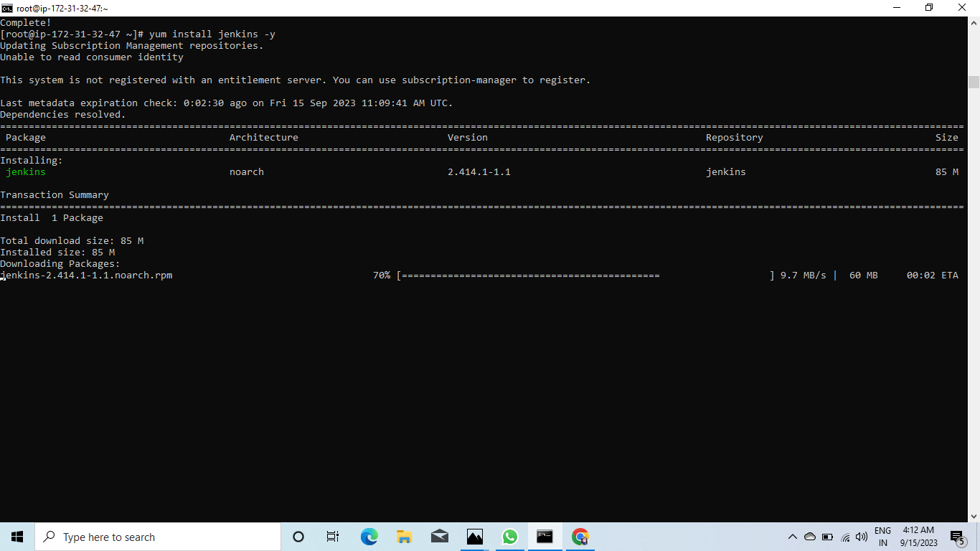

Slide 16
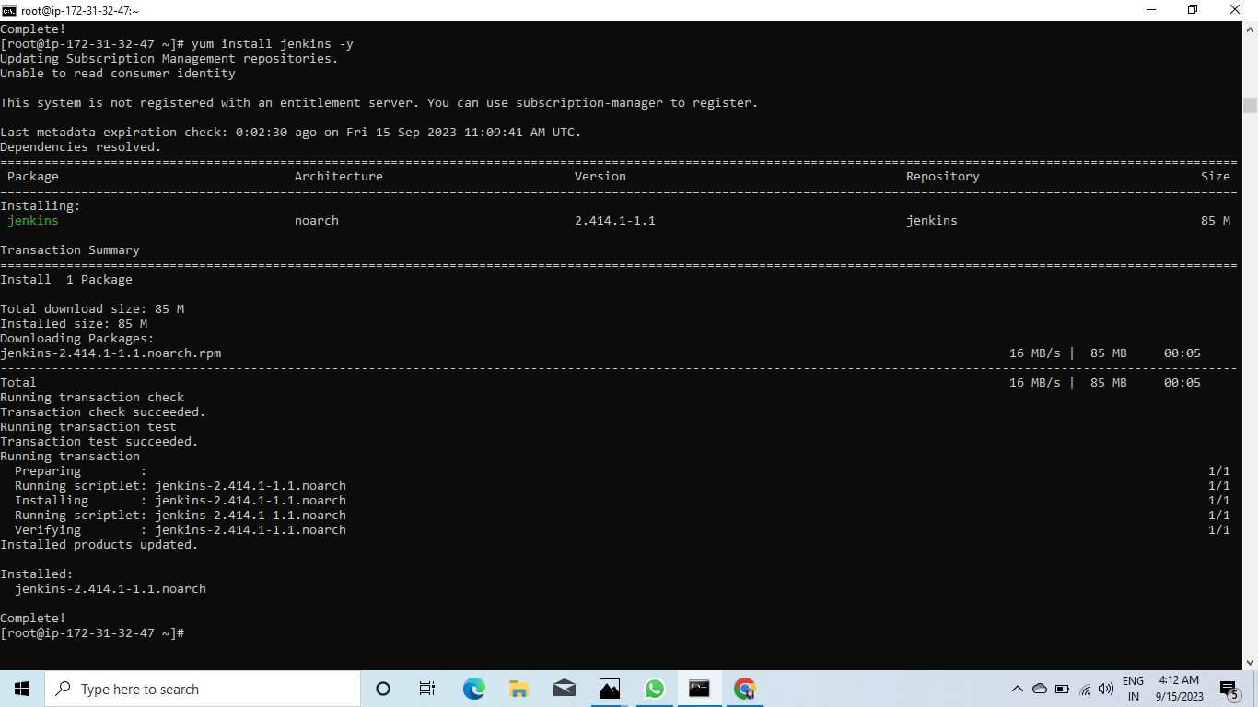

Slide 17
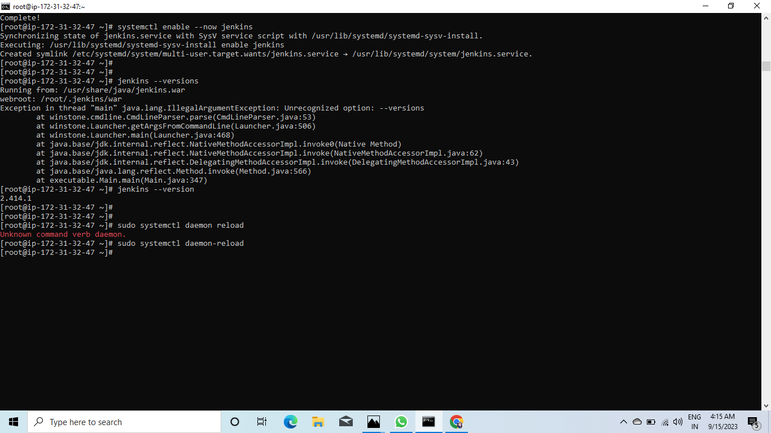

Slide 18
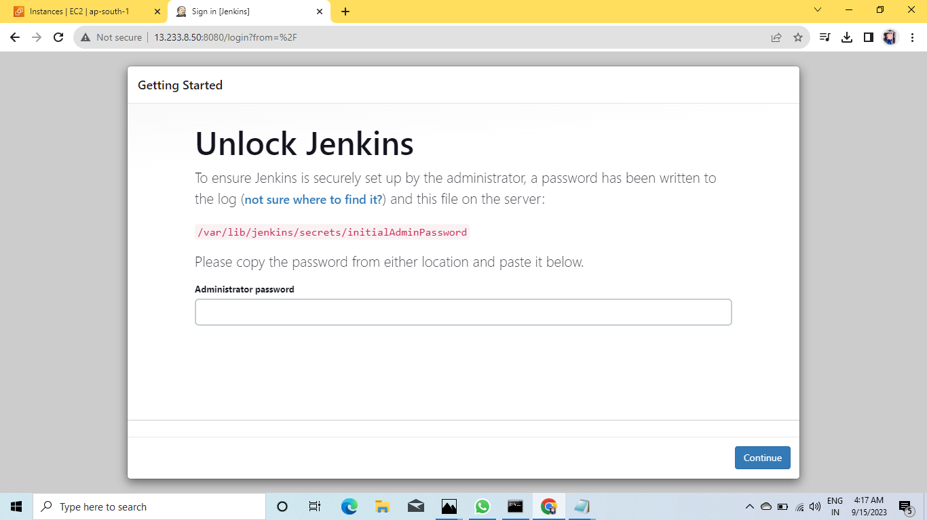
PASTE THE PUBLIC IP ALONG WITH :8080

Slide 19
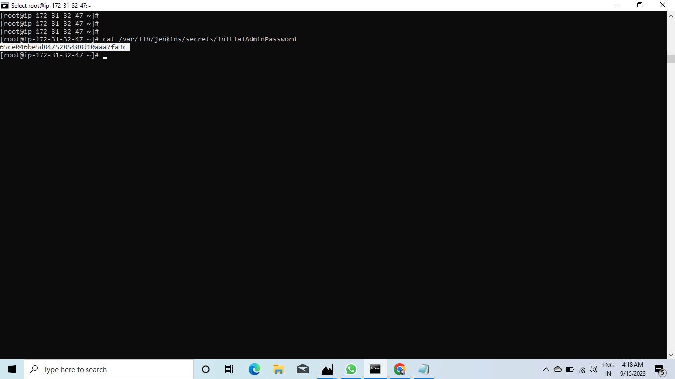
RUN A COMMAND FOR PASSWORD:-

Slide 20
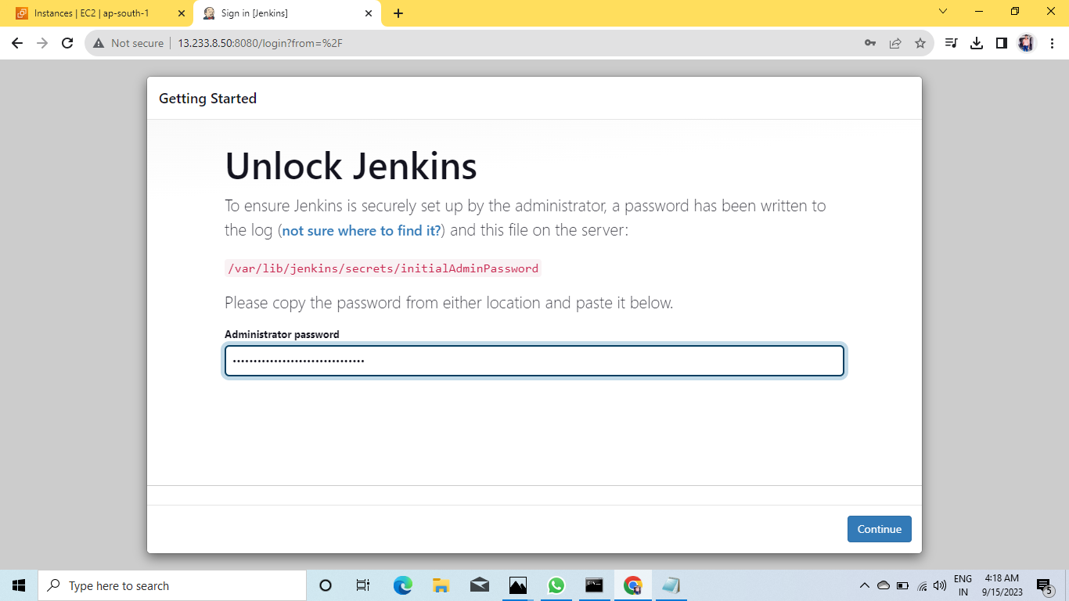
PASTE THE PASSWORD:-

Slide 21
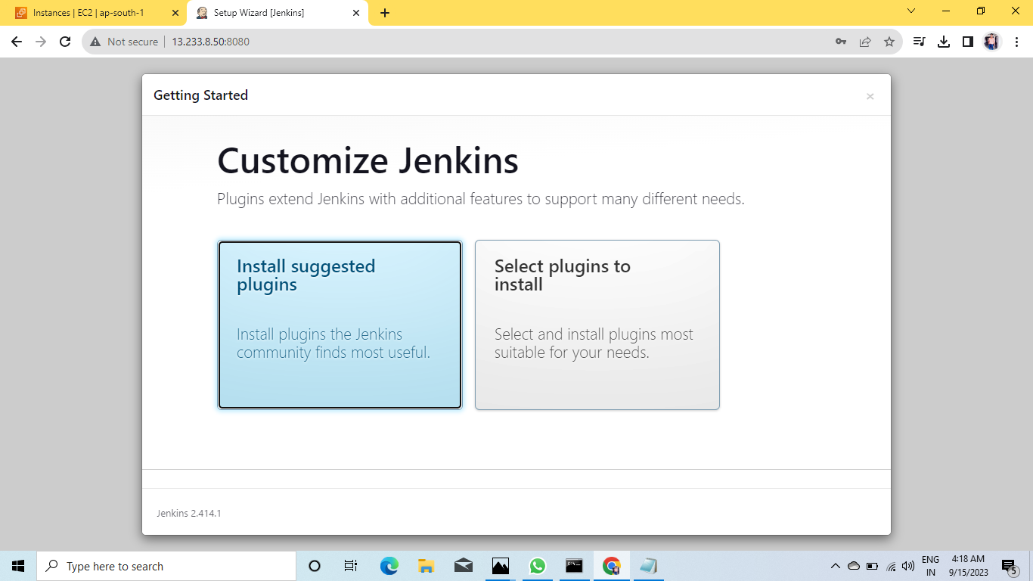
INSTALL SUGGESTED PLUGINS:-

Slide 22
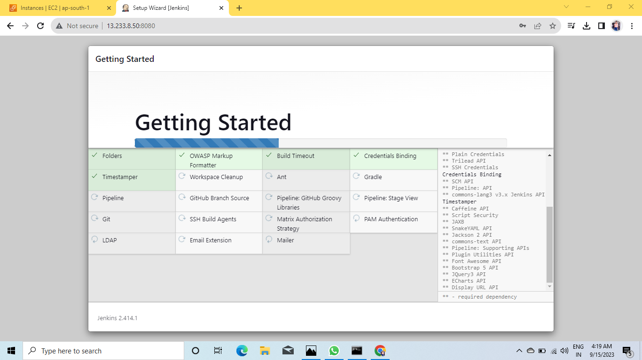
WAIT FOR SOME TIME:-

Slide 23
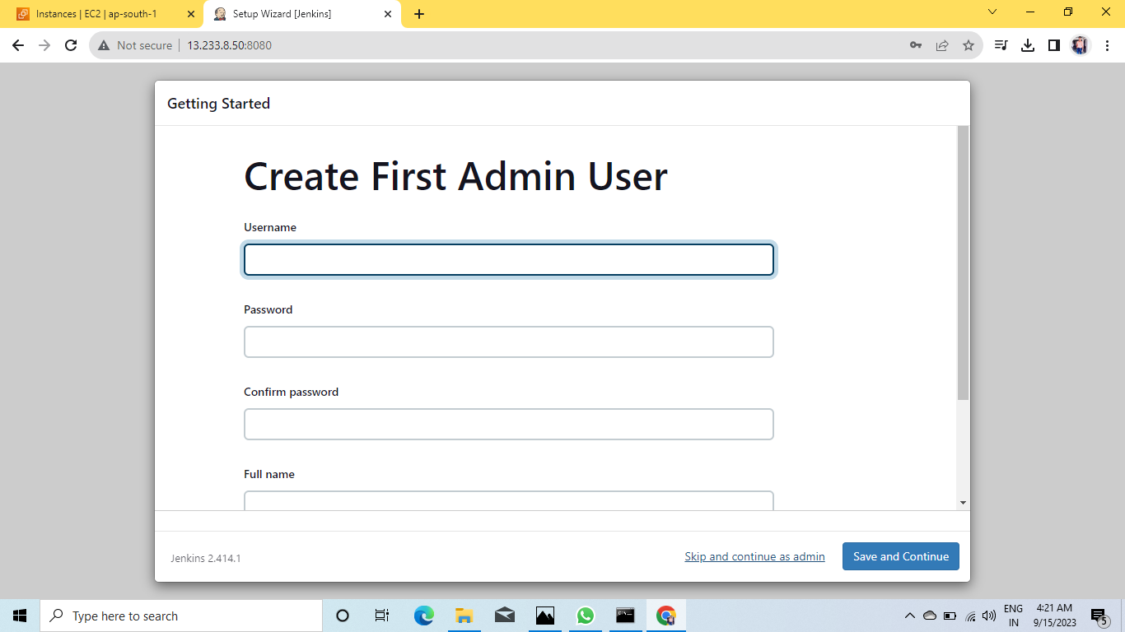
SKIPAND CONTINUE AS ADMIN:-

Slide 24
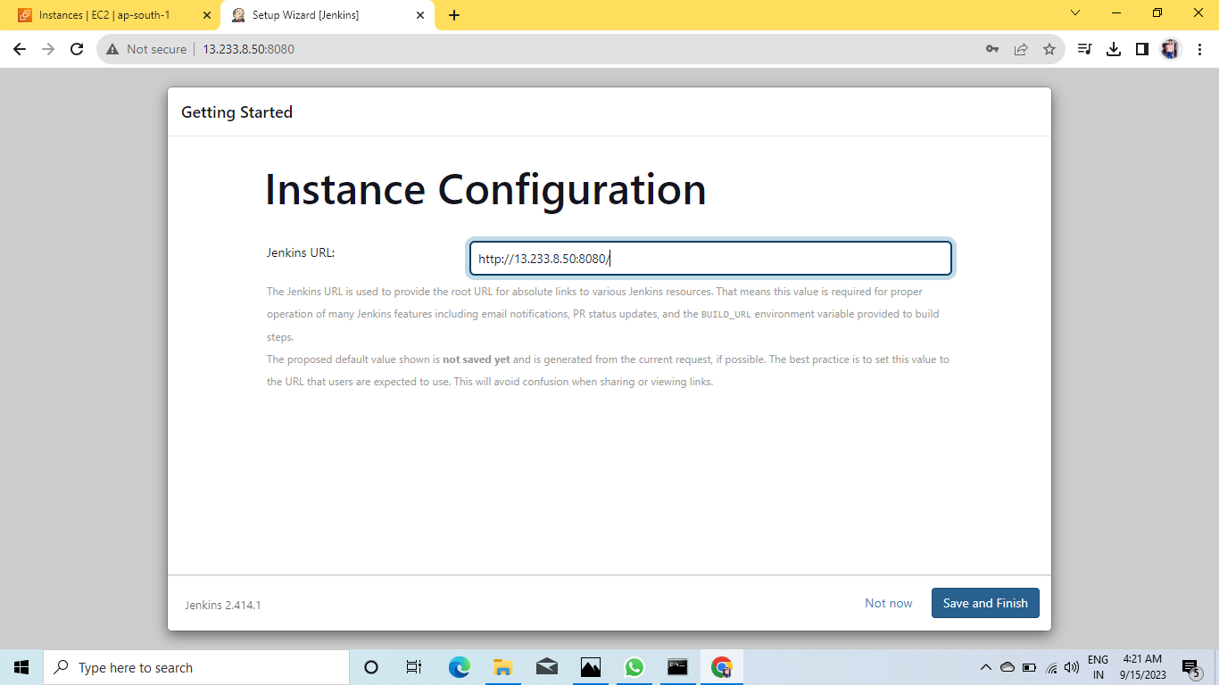
SAVE AND FINISH:-

Slide 25
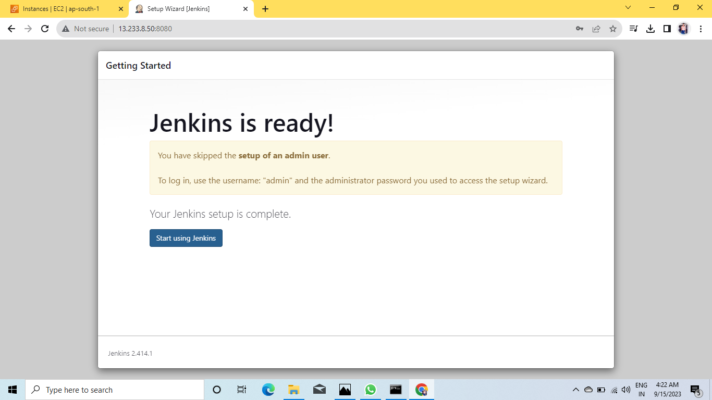
JENKINS IS READY:-

Slide 26
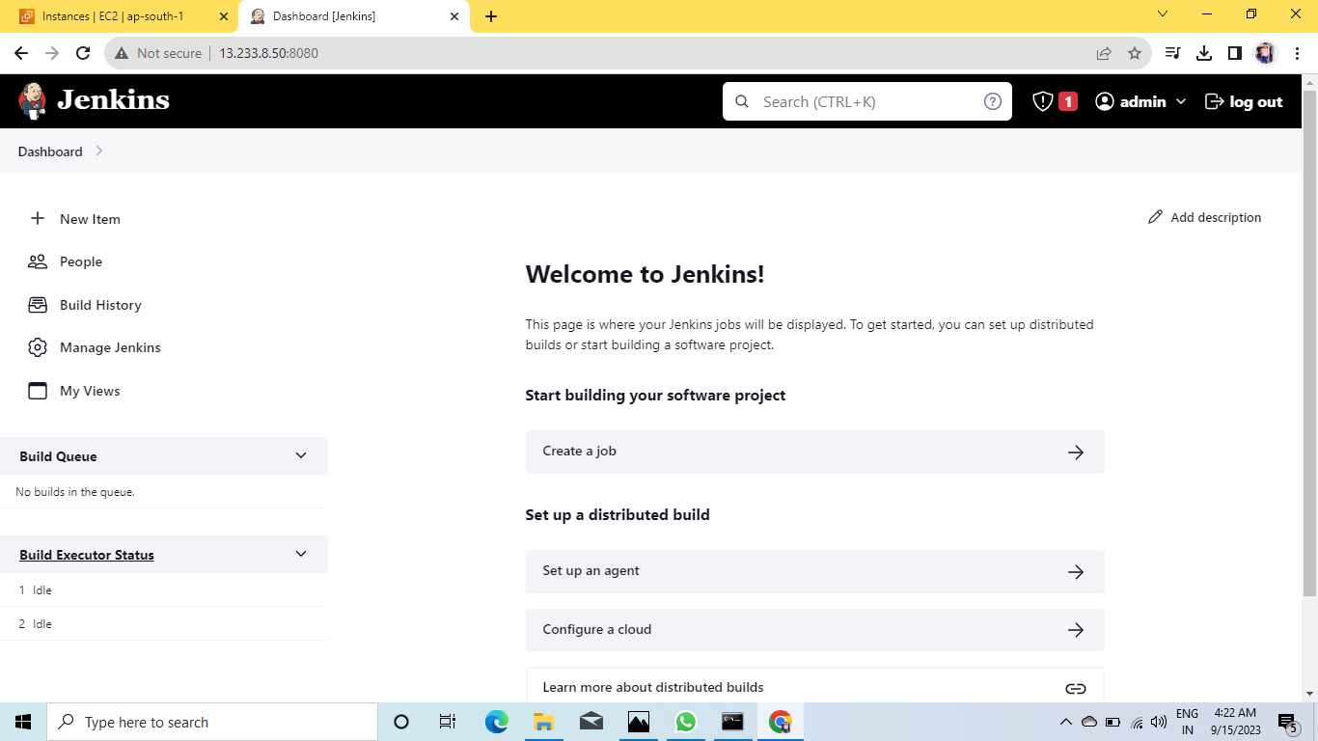
DASHBOARD OF JENKINS:-

Slide 27
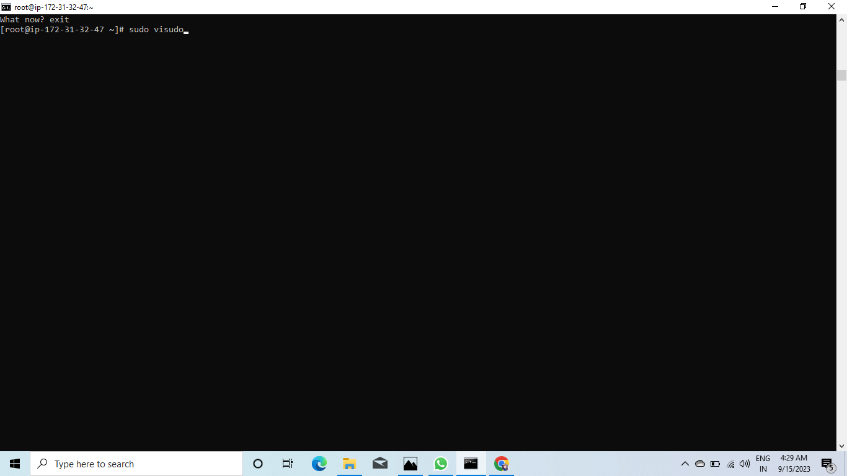
RUN A COMMAND SUDO VISUDO:-

Slide 28
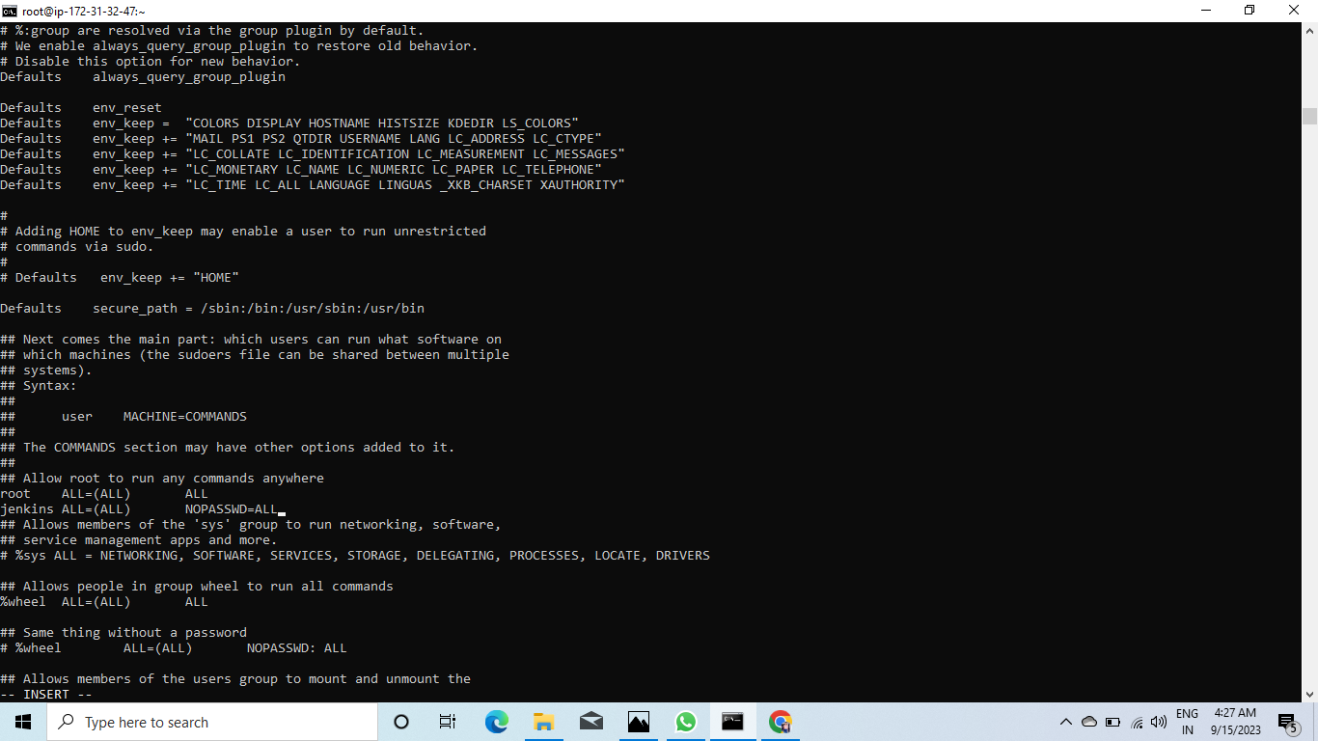
SEE BELOW THE ##ALLOW ROOT:-

Slide 29
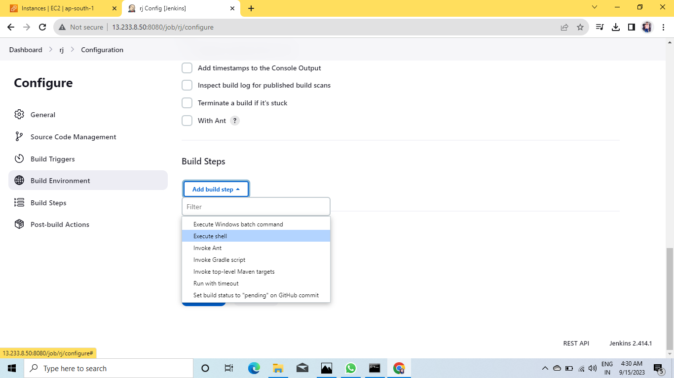

Slide 30
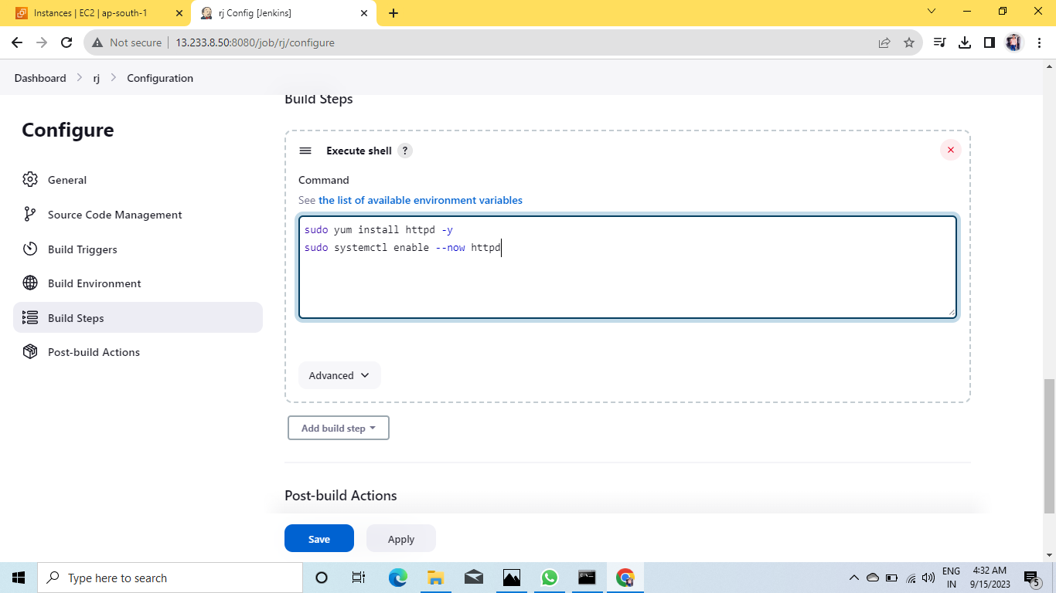
SEE THE COMMAND IN EXECUTE SHELL THEN APPLY AND SAVE:-

Slide 31
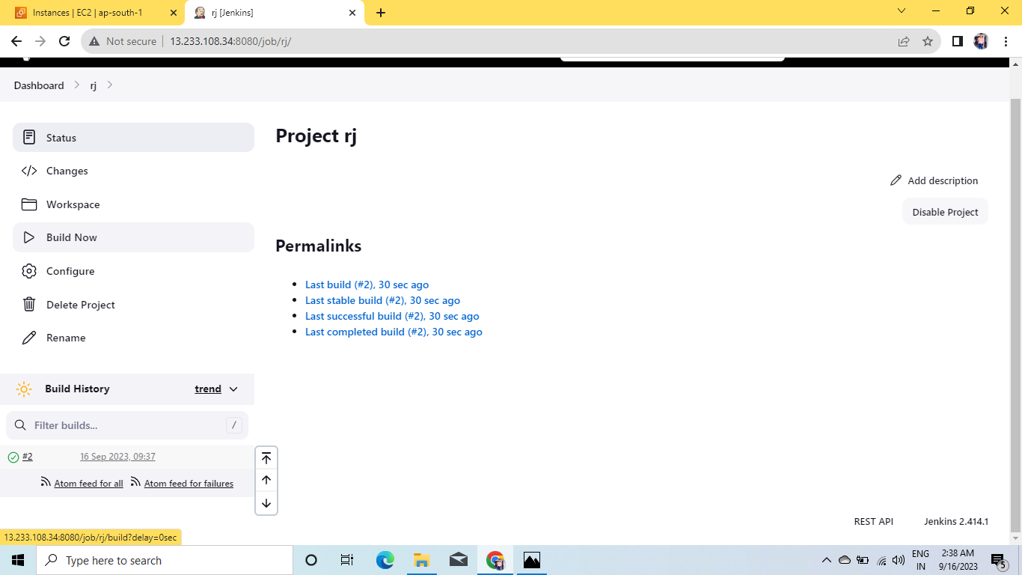
BUILD NOW:-

Slide 32
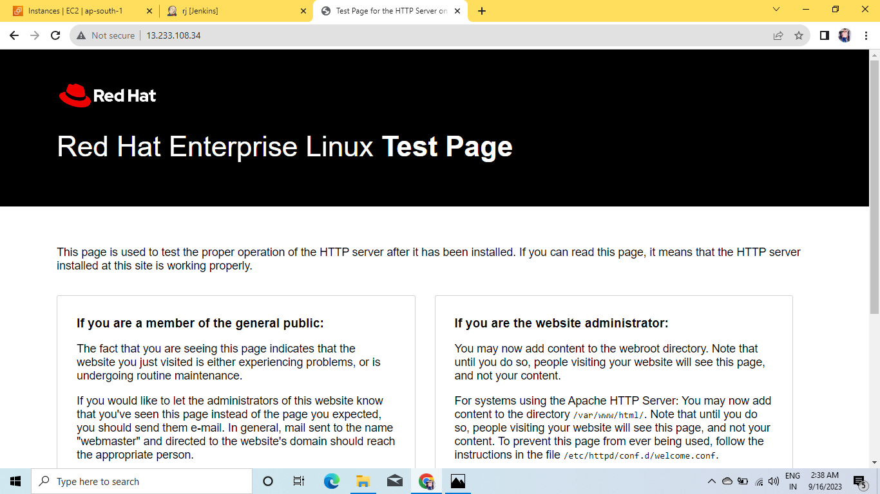
PASTE THE PUBLIC IP:-

Slide 33
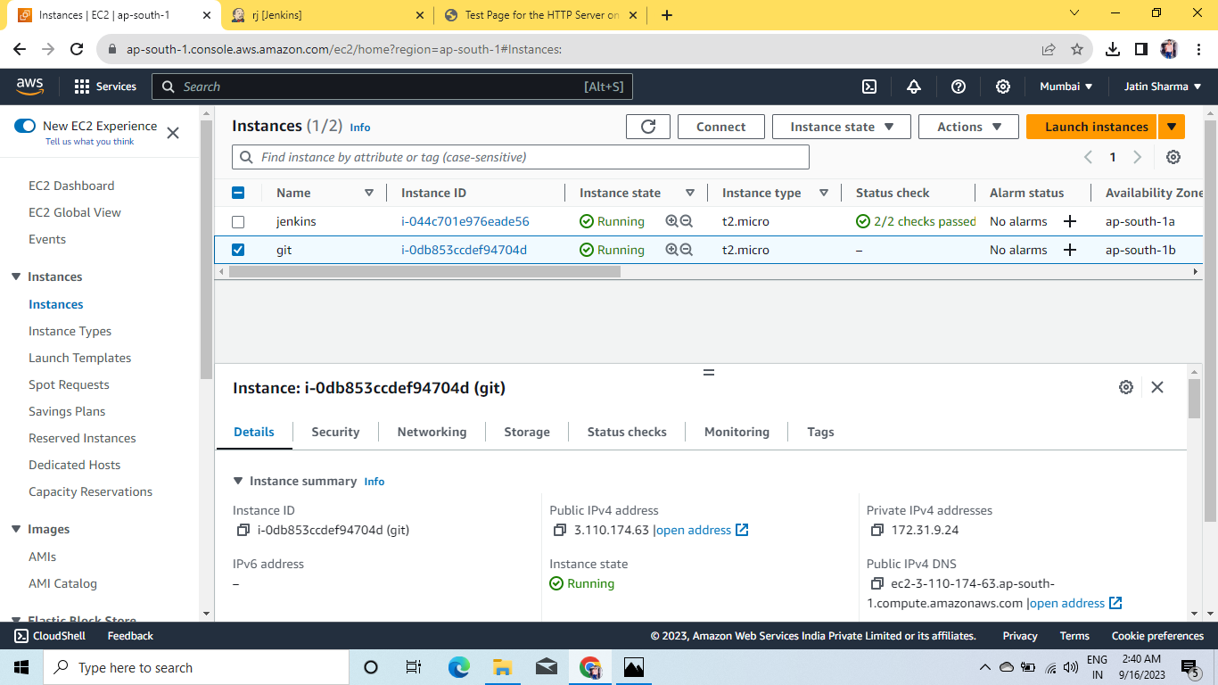
LET’S DO THE INTEGRATION IN GIT:-

Slide 34
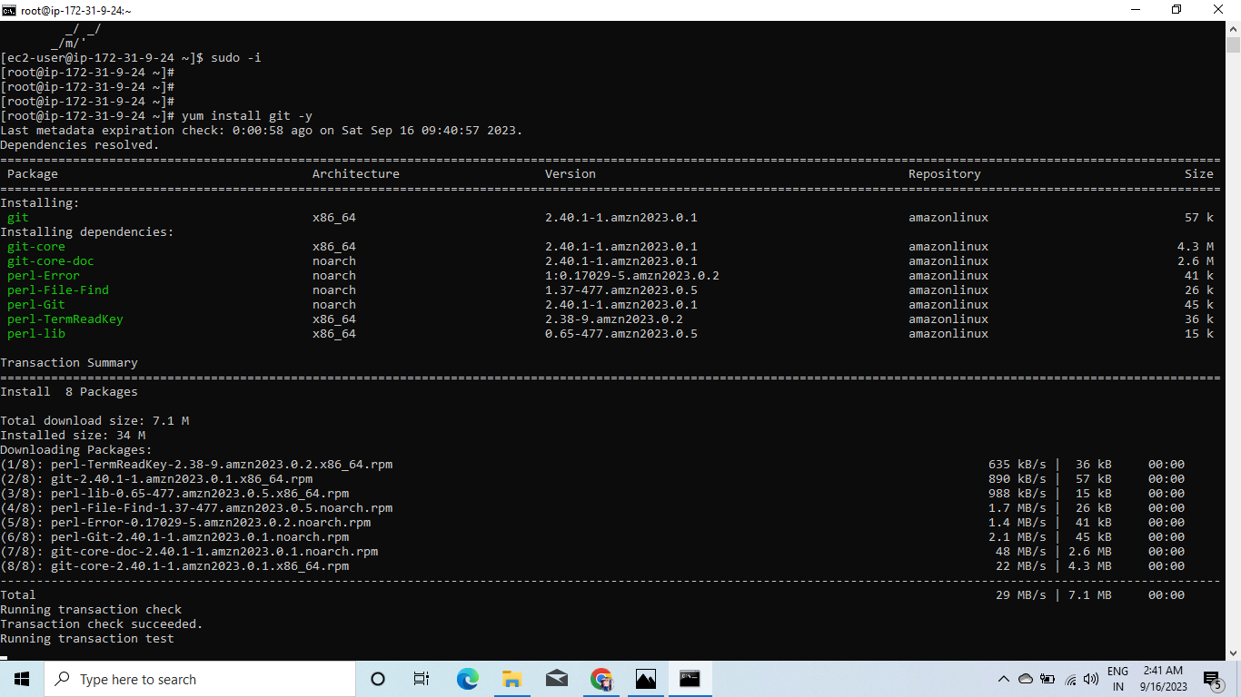
INSTALL GIT IN ANOTHER INSTANCE:-

Slide 35
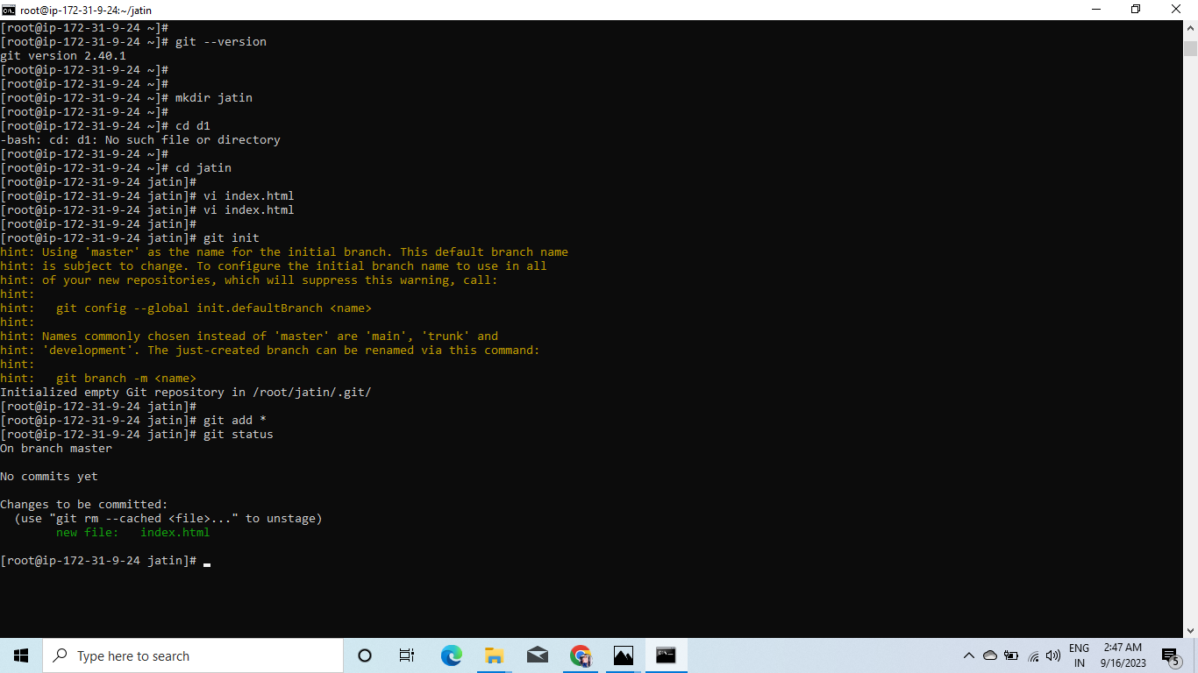
INPUT SOME CODE IN INDEX.HTML AND DO SAME AS FOR JATIN.HTML

Slide 36
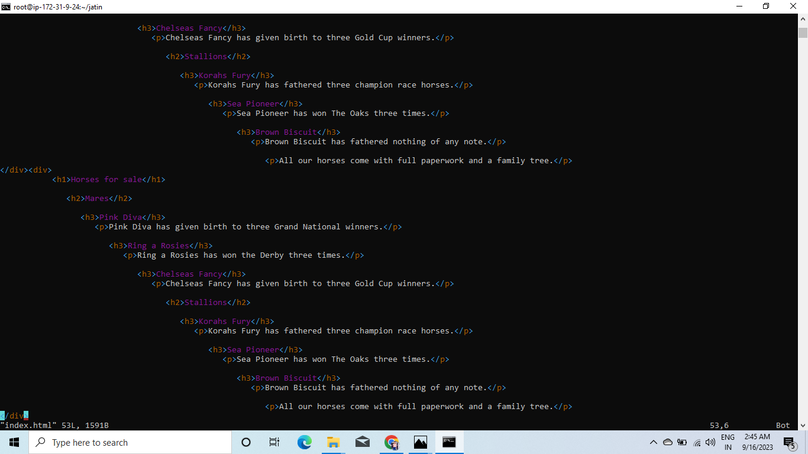

Slide 37
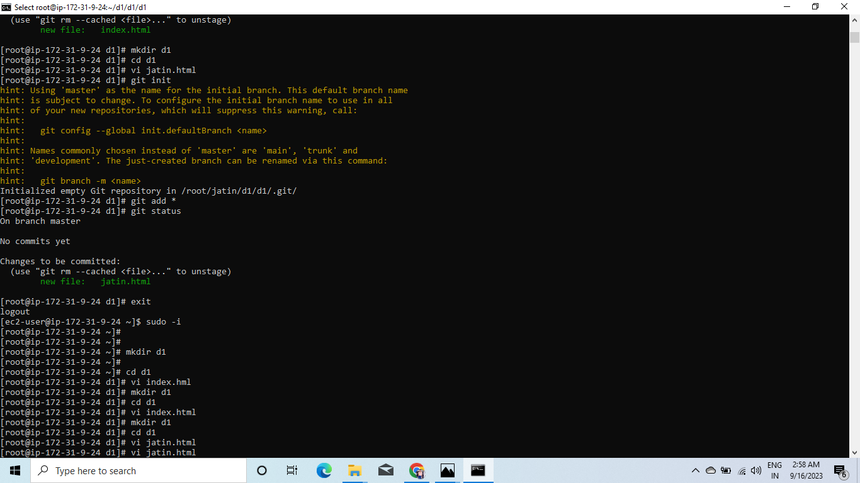

Slide 38
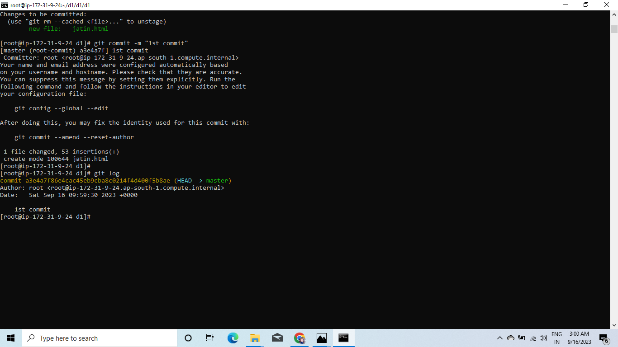
CHECKING THE GIT STATUS:-

Slide 39
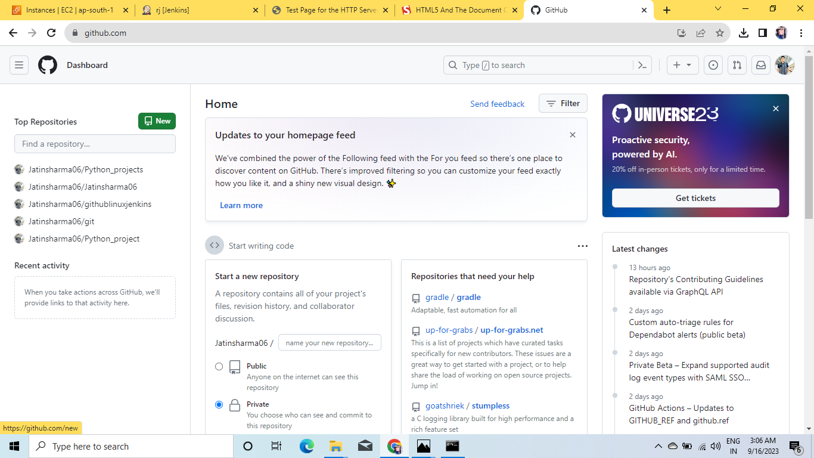
LOGIN GIT HUB AND CREATE NEW REPO:-

Slide 40
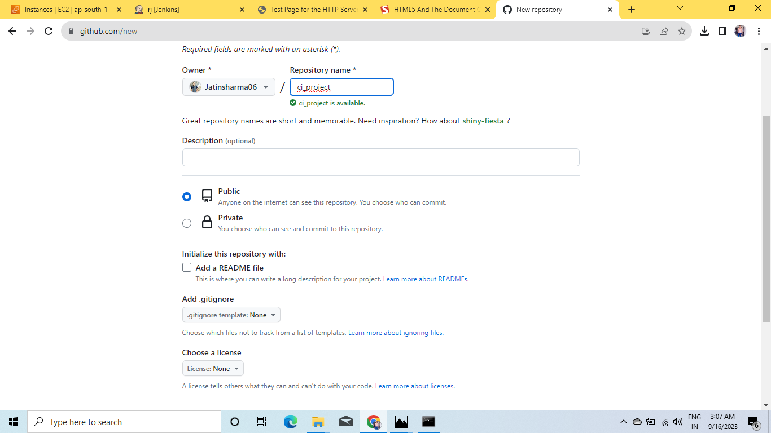

Slide 41
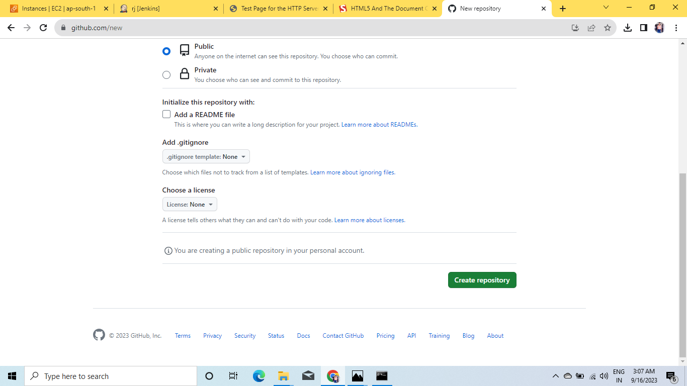

Slide 42
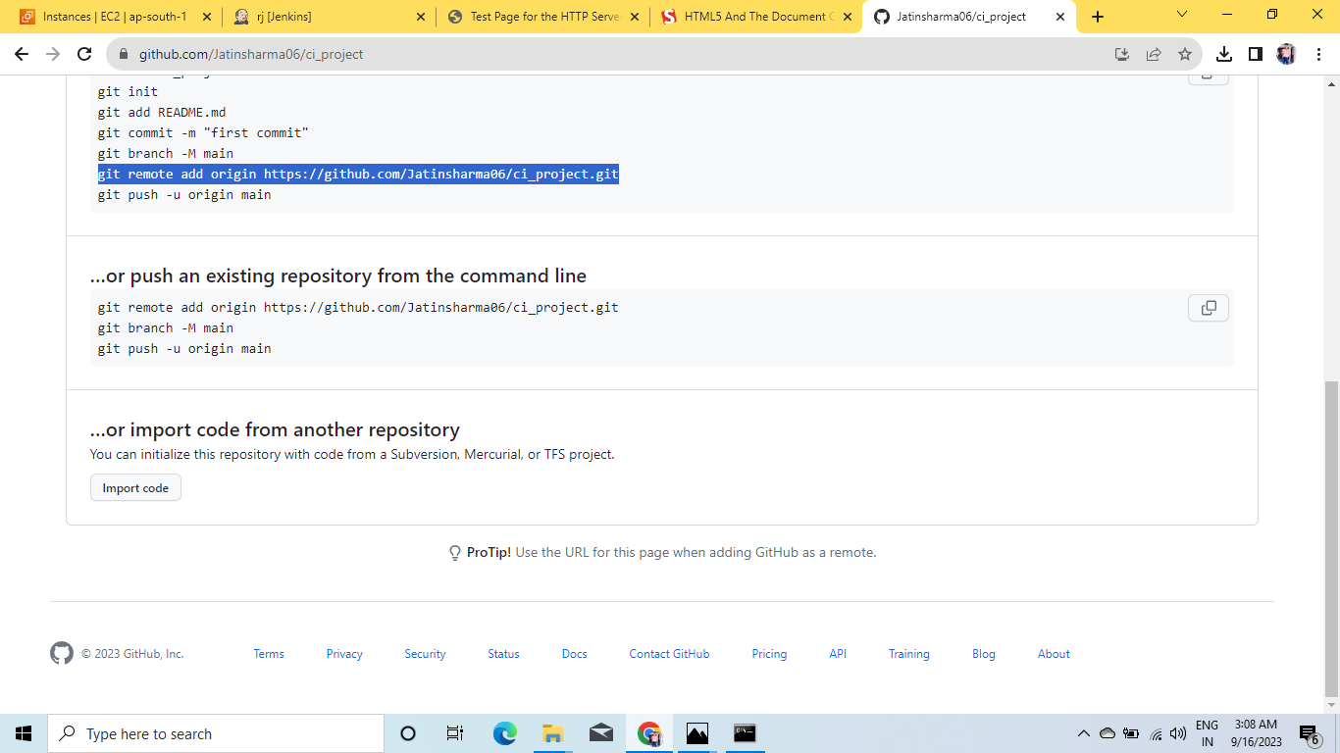
COPY AND PASTE REMOTE ORIGIN ON CMD:-

Slide 43
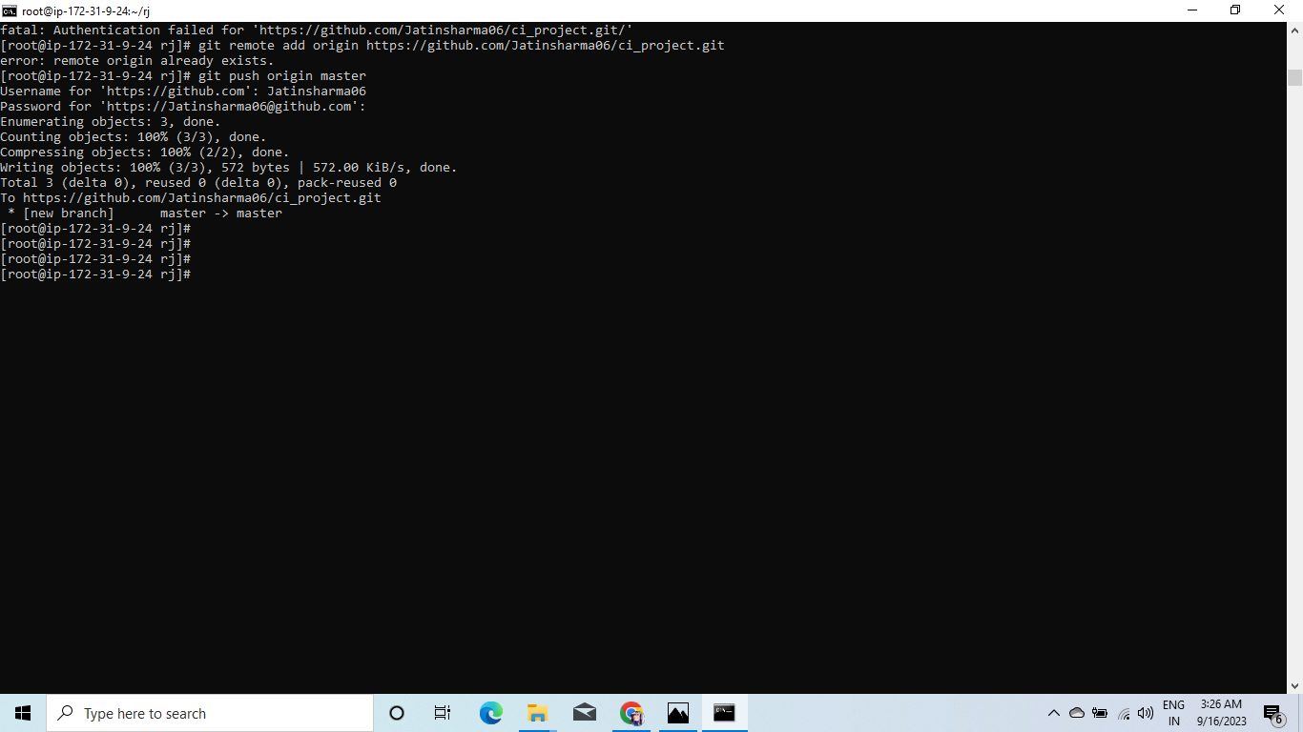
PUSH THE ORIGIN MASTER:-

Slide 44
GENERATION OF PAT(PERSONEL ACCESS TOKEN:-
CLICK ON PROFILE ICON
SETTINGS
DEVELOPER SETTINGS
PAT
CLASSIC
GENERATE TOKEN
CHECK ON REPO
NAME OF THE TOKEN
GENERATE NEW TOKEN
COPY THE TOKEN AND SAVE IN A NOTEPAD FILE FOR FUTURE USE…

Slide 45
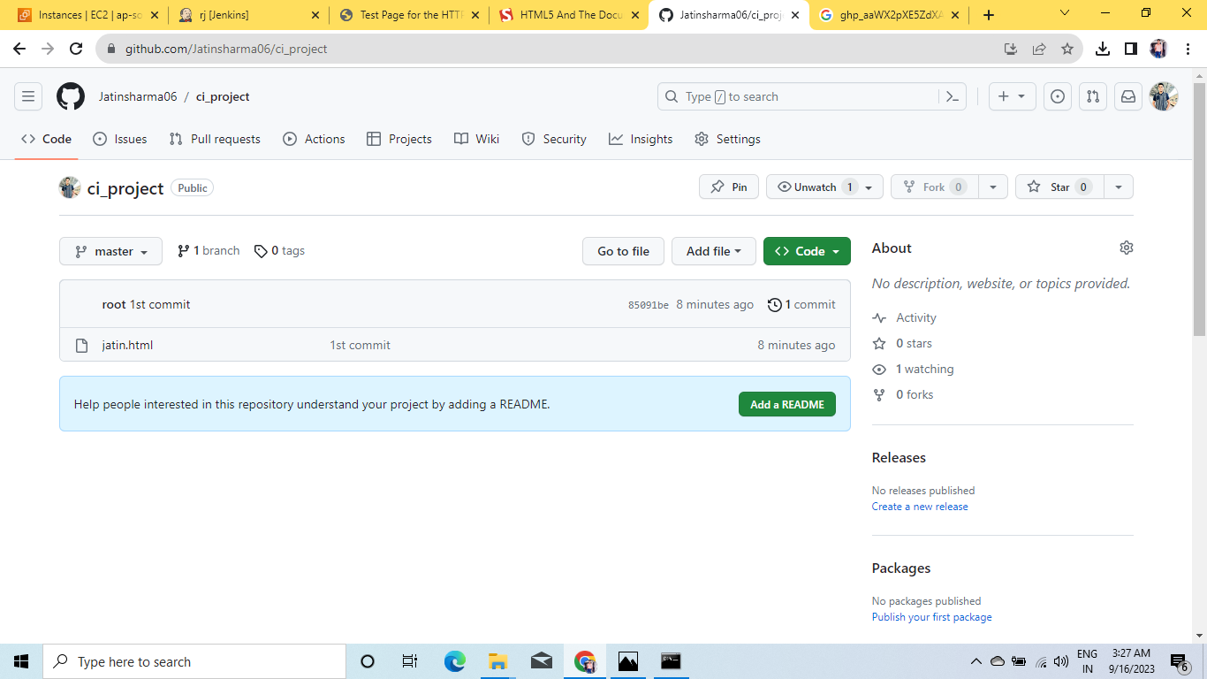
AS U CAN SEE THE HTML FILE IN REPO:-

Slide 46
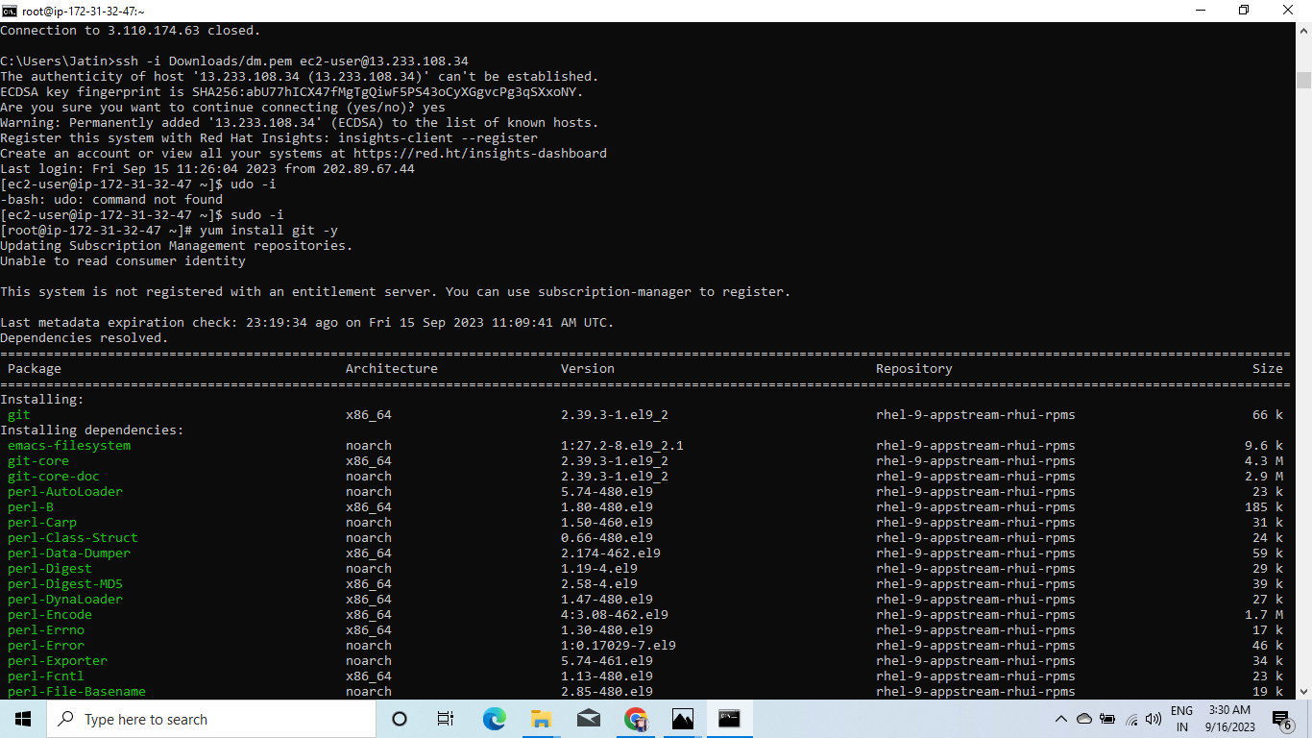
INSTALL GIT ON JENKINS MACHINE:-

Slide 47
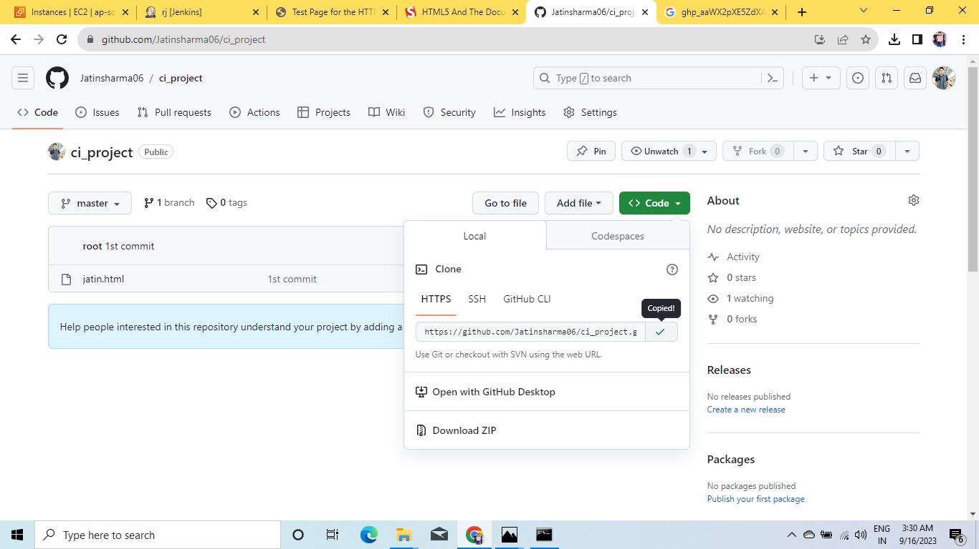
COPY THIS URL:-

Slide 48
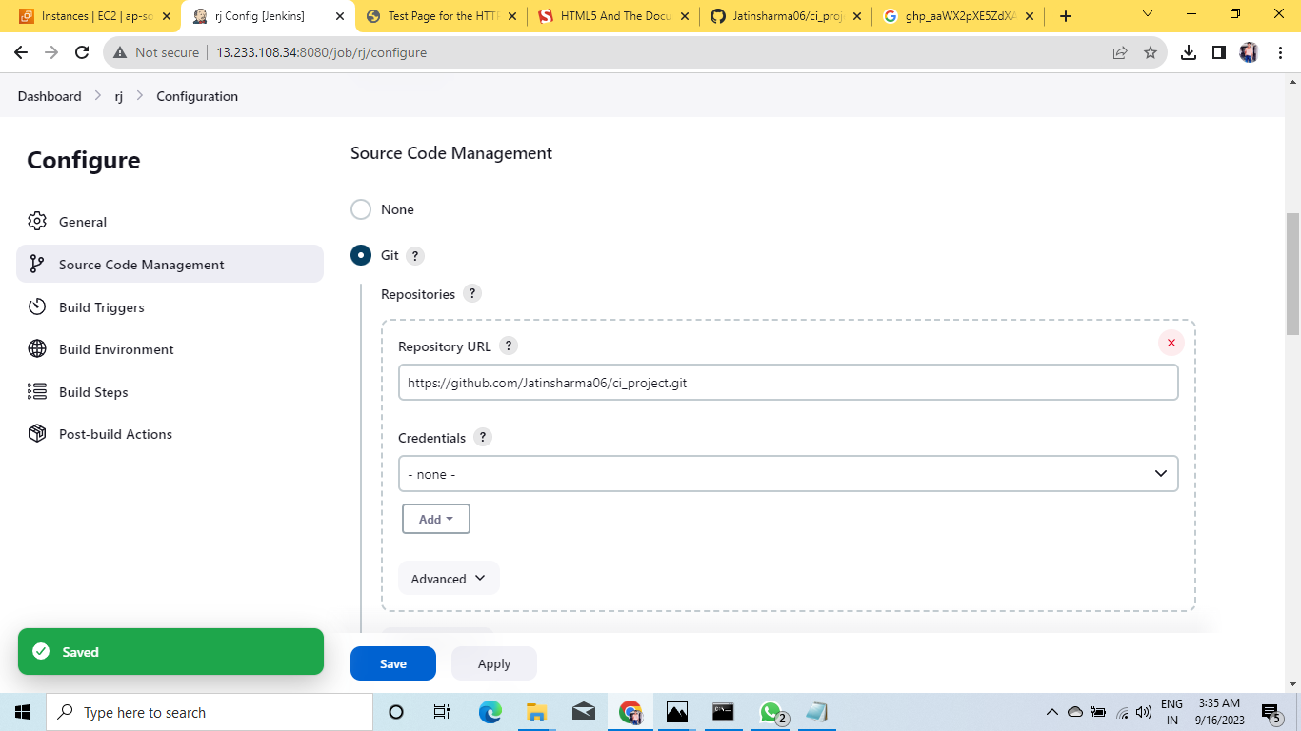
ON JENKINS PAGE>GIT>PASTE THE URL:-

Slide 49
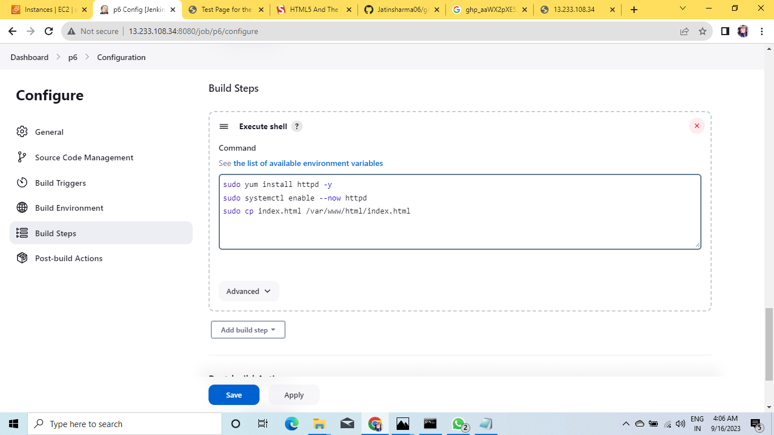
ADD THE FOLLOWING COMMAND IN EXECUTE SHELL BOX:-

Slide 50
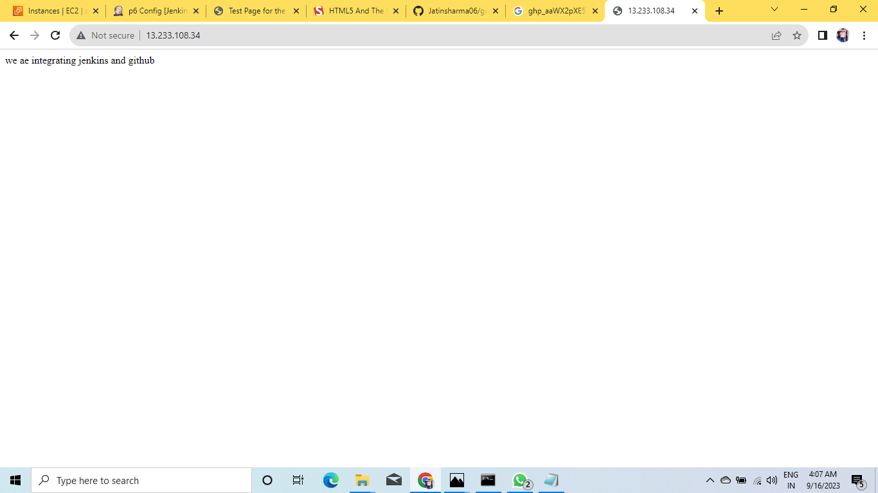
PASTE THE PUBLIC IP ON GOOGLE:-

Slide 51
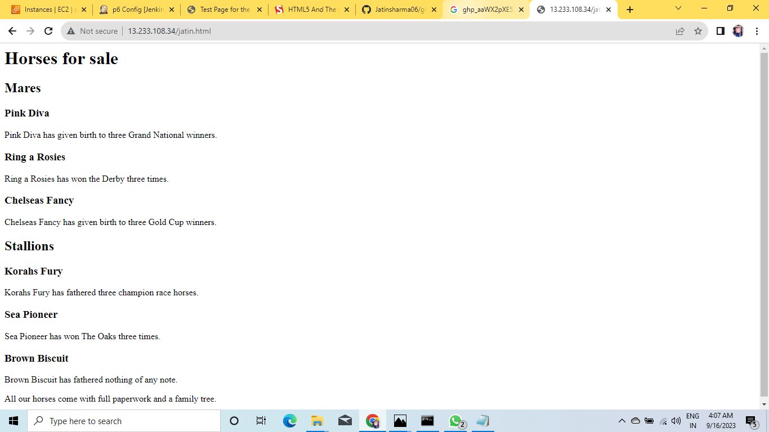
PASTE IP/JATIN.HTML TO SEE ON THIS WEB:-

Slide 52
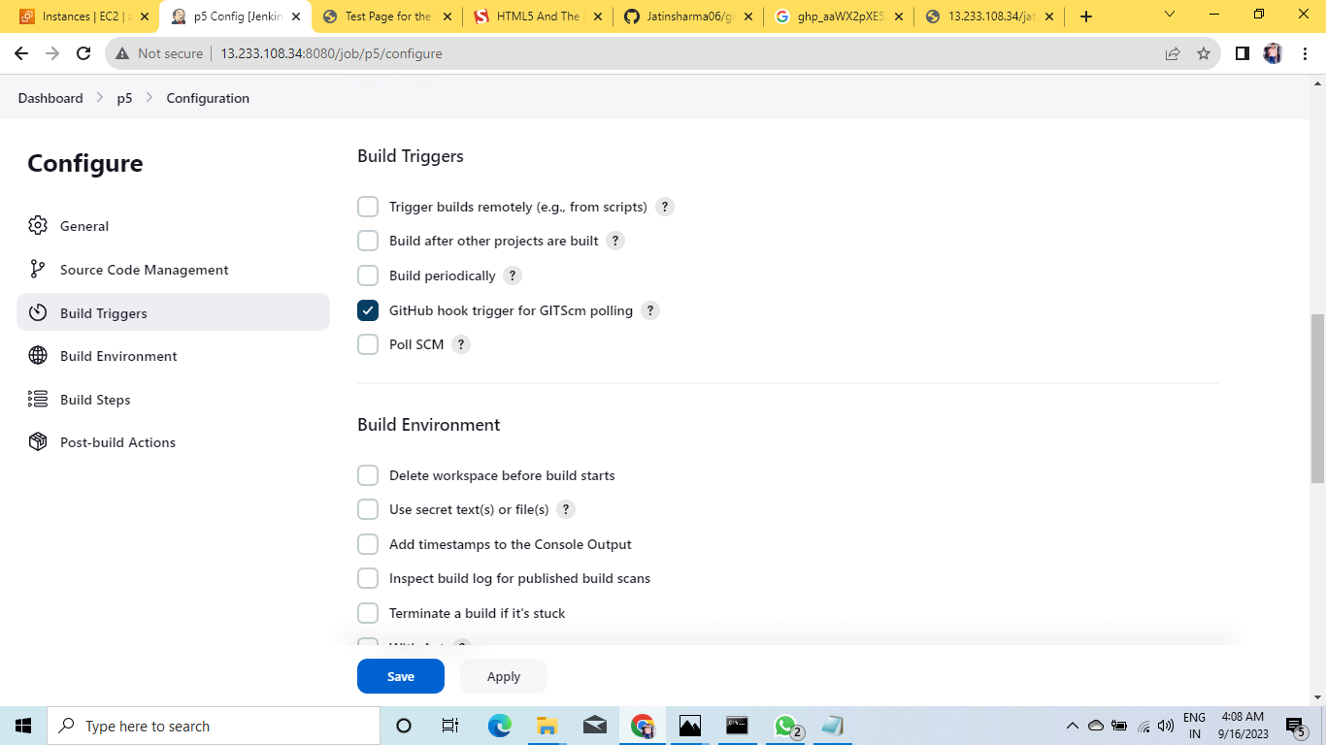
CI PIPELINE USING GITHUB WEBHOOKS:-

Slide 53
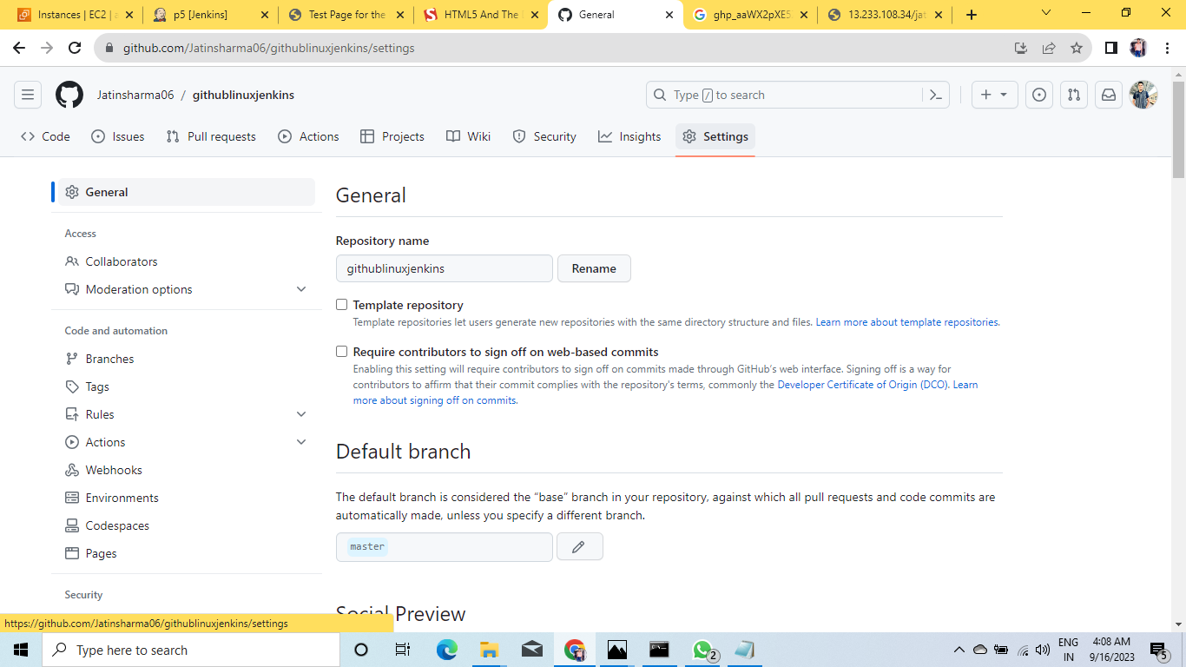
PROCESS OF ADDING WEBHOOK:-

Slide 54
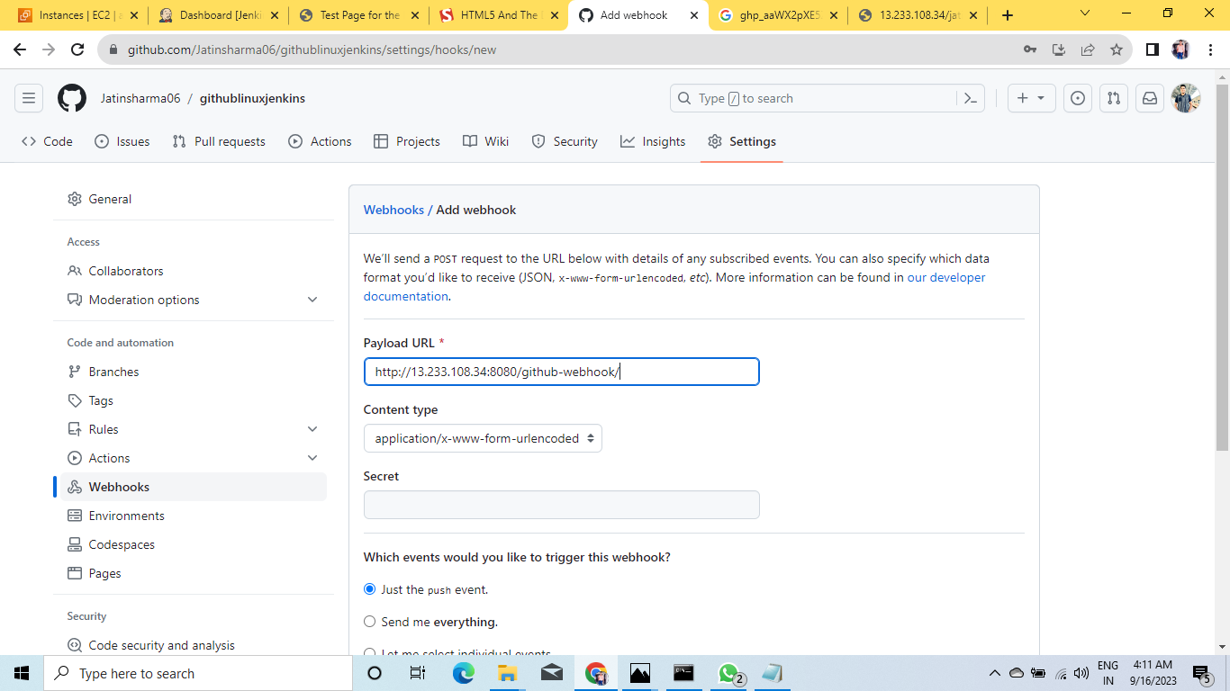
PASTE IP:8080/GITHUB-WEBHOOK/

Slide 55
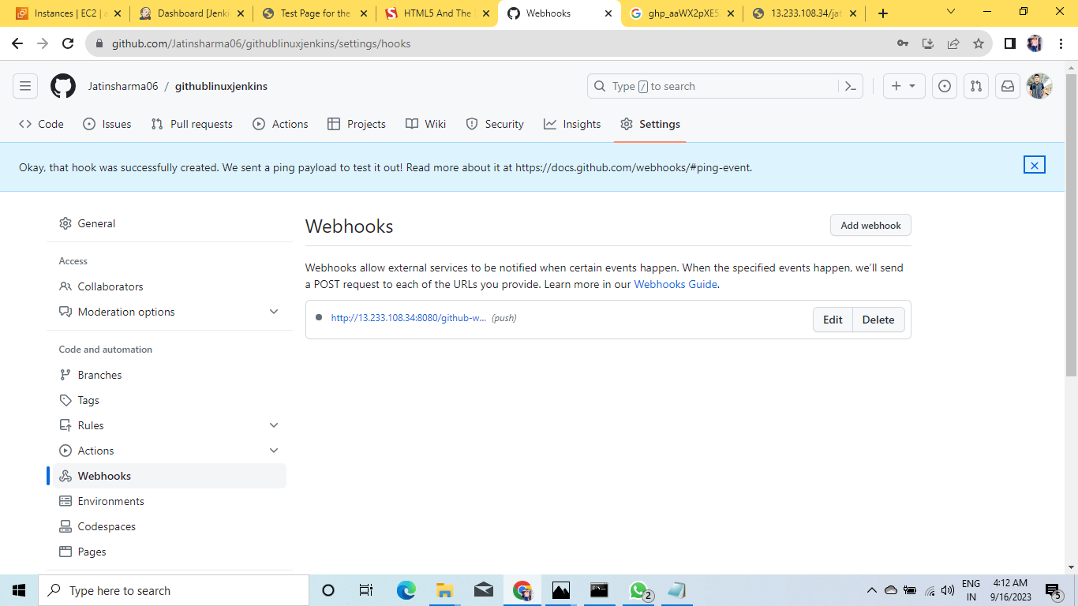
WEBHOOK ADDED SUCCESSFULLY:-

Slide 56
MODIFICATION PROCESS:-
1. AS U CAN EDIT IN DEVELOPER MACHINE DO THE CHANGES IN FILES TO SEE THE CHANGES ARE REFLECTED AUTOMATICALLY..
2. AFTER THIS YOU HAVE TO COMMIT AND PUSH THE ORIGIN MASTER..
3. ENTER THE USERNAME AND PASTE THE PAT...

Slide 57
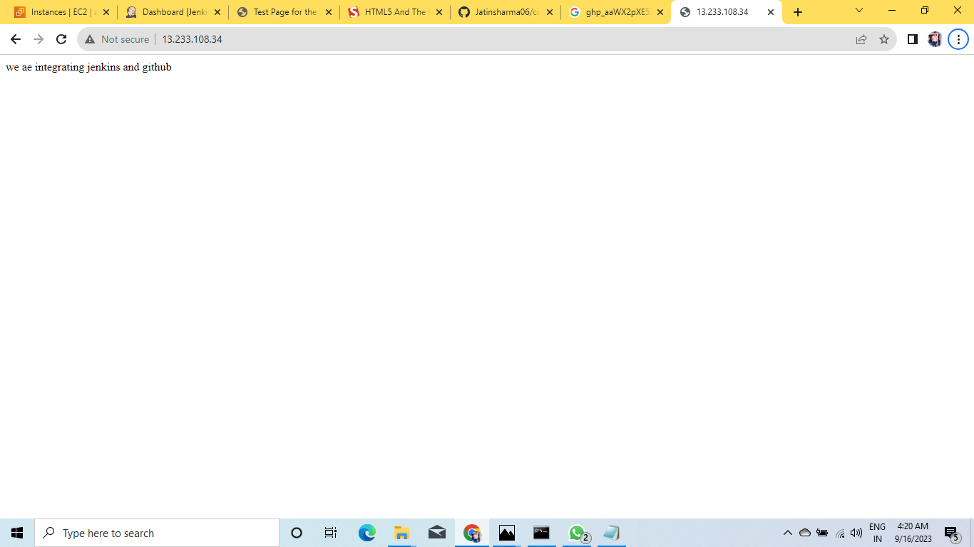
REFRESH THE WEB PAGE AND ABLE TO SEE THE CHANGES:-
.
.
.
.
HII I AM ALWAYS THERE FOR U…..
THANKS LEARN AND BUILD

Slide 58
SPECIAL THANKS TO:-
[MR.ASHISH SIR} FOR THE VALUABLE GUIDANCE THROUGHOUT THE INTERNSHIP…!!

Slide 59

THANK YOU!
YOUR:- JATIN SHARMA
Email:
jattunanu2003@gmail.com
linkedin:
https://www.linkedin.com/in/jatin-sharma-46b40124b

